Slide 1
Detection of COVID19 and Pneumonia using Chest X-ray Images
Group -10
Arundhati Mishra - 801272741
L Srujitha Gali - 801307126
Shreya Biswas - 801287328
Kylan O’Neal -

Slide 2
Introduction
1.The novel coronavirus disease, which originated in Wuhan, developed into a severe public health problem worldwide.
2.A critical step in the fight against COVID-19 is effective screening of infected patients, with one of the key screening approaches being radiology examination using chest radiography. It was found in early studies that patients present abnormalities in chest radiography images that are characteristic of those infected with COVID-19.
3.As we have witnessed during 2020 and 2021 ,detecting Covid-19 through chest xray was the best approach,It was evident that in many cases Rt-Pcr test results were false negative .The delay detection of Covid -19 had lead to the life of many patients.
4.Our project aims on accurately predicting that whether a person is healthy, is covid positive or is pneumonic from their chest radiography images.

Slide 3
Problem And Motivation
1.Problem statement : Detection of covid19 and pneumonia in a person using their chest x ray images.Covid19 is a serious health issue all around the world. With the increased number of deaths there is a dire need in medical science to improve the performance of technologies by incorporating computer vision models to make predictions when chemical testing is not an option or there is no expert radiologist on hand.
3.Motivation - Our main motivation was to create something that solves a real life problem and is the need of the hour.
4.We wanted to work on this kind of health care project which will be beneficial in the future for this sector.
5.Our model will aid healthcare providers in the detection and diagnosis of COVID-19/pneumonia.
6.Many patients are asymptomatic yet are positive for COVID-19.
7.Chemical testing is costly and slow. Diagnosis using chest x-ray images requires a specialist who has expert knowledge.
8.A deep learning approach can solve these issues because it is fast, cheap, and potentially highly accurate

Slide 4
Introduction and Contribution of Team
1.Research(Stage 2) was equally done by all the members .
2.The responsibility of Data Collection was taken by Arundhati and Shreya.
3.The Data Processing was done by the Kylan and Srujitha .
4.Data Modelling(Stage 4) was done equally by everyone by sharing a common colab notebook which everyone had access to.
5. Kylan made the demo application

Slide 5
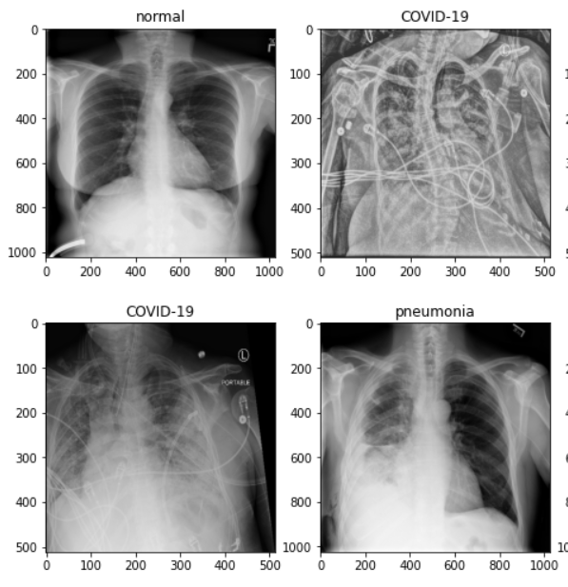
Dataset
1.The COVIDx CRX-3 dataset will be used to train the model
2.COVIDx is a publicly available, open-access benchmark dataset comprised of 29,986 chest X-ray images from 16,648 patients. The images are labeled as one of three classes: no pneumonia/non-COVID-19 pneumonia/COVID-19 pneumonia.

Slide 6
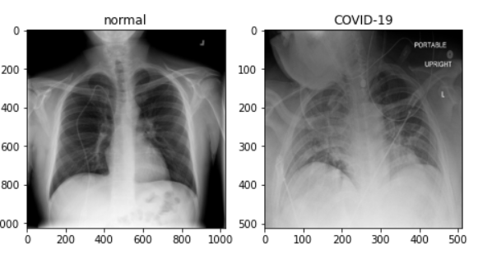
Dataset
Training Split
55% COVID-19 Pneumonia
18.5% Non-COVID Pneumonia
26.5% Normal
Testing Split
400 professionally annotated images
50% COVID-19 Pneumonia
25% Non-COVID Pneumonia
25% Normal
The creators of COVIDx compiled the dataset from several publicly available sources.
Actualmed COVID-19 Chest X-ray Dataset Initiative,
COVID-19 Radiography Database - Version 3,
RSNA International COVID-19 Open Radiology Database
Updated as recently as 06/02/2022, COVIDx was the clear choice for our model due to the large number of samples and labels that are specific to our problem

Slide 7
Methodology
Based on our research, DCNNs are the best approach
Build custom model from scratch using intuition-based approach
Experiment pre-trained models (VGG16, ResNet18, AlexNet)
Fine-tuning
Feature extractors
Compare results

Slide 8
Custom Model Options
Batch normalization layers
Number and position of dropout layers
Dropout rate
Activation functions
Number of fully connected layers
Number of input/output neurons
Data augmentation (horizontal flip)
Zero-centering
Batch size
Image size
Learning rate
Learning rate decay
Optimizer algorithm
Number of epochs
Number of convolutional layers
Number of max pool layers
Kernel sizes
Stride lengths
Padding amount
Number of filters

Slide 9
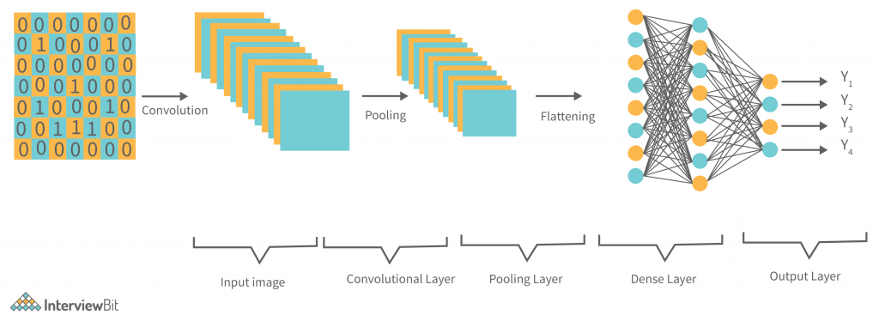
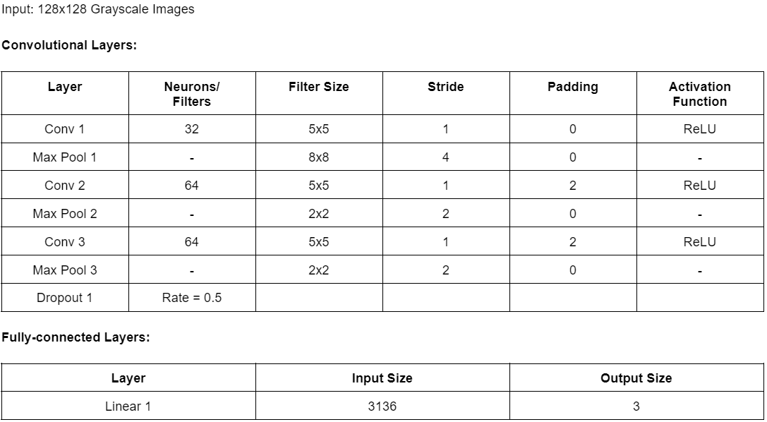
Custom Model Architecture

Slide 10
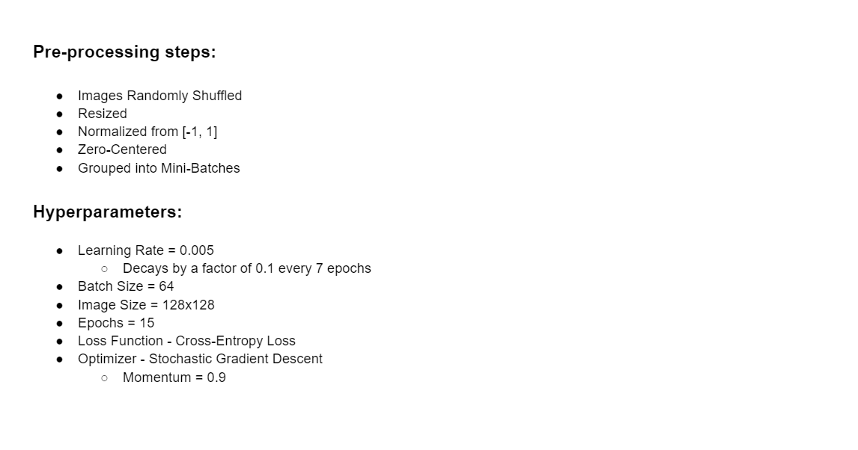

Slide 11
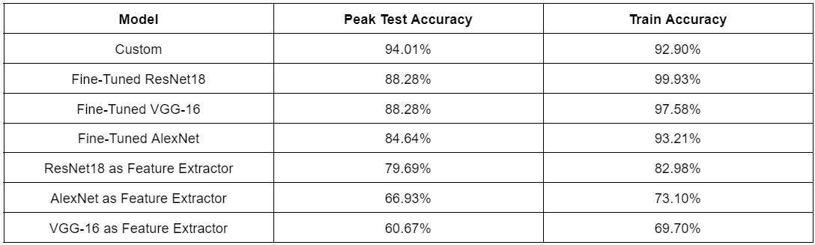
Results

Slide 12
Conclusion
Our objective has been to program a computer vision model that would load and predict x-ray images into three classes.
Using an intuition-based approach, we have created a custom model that outperforms pre-trained models
This was possible because of the very large COVID-X dataset
This is not an industry ready solution
Almost 100% accuracy is required to make medical decisions
Can’t replace chemical tests or expert diagnosis
To show you how our model could be used in order to make some preliminary decisions, we have made a simple demo app that could be used by healthcare providers

